Slide 1
STUDENT NAME: M. SRILEKHA
Asumn293222403905
DEPARTMENT:II BSC COMPUTER SCIENCE WITH DATA SCIENCE
College: vidhya sagar women’s college/madras University

Slide 2
PROJECT TITLE
SRILEKHA’S Personal Portfolio Website

Slide 3
AGENDA
• Problem and Statement
• Project Overview
• End users
• Tools and Technlogies
• Portfolio design and layout
• Features and Functionality
• Results and Screenshot
• Conclusion
• Github Link

Slide 4

PROBLEM STATEMENT
Develop a responsive and interactive personal portfolio website using HTML and CSS.Showcasing your personal and professional information, including profile details, skills. Certificate uploads, contact form, and resume download functionality.

Slide 5

PROJECT OVERVIEW
Design and develop a visually appealing and responsive portfolio website using HTML and CSS, showcasing your profile, achievements. And contact information with modern UI features.

Slide 6

END USERS
This portfolio website is designed for showcasing your professional identity and skills. The primary end users are

Slide 7

TOOLS AND TECHNOLOGY
This creative portfolio is built using core front-end technologies to ensure it is responsive, modern, and professional.

Slide 8
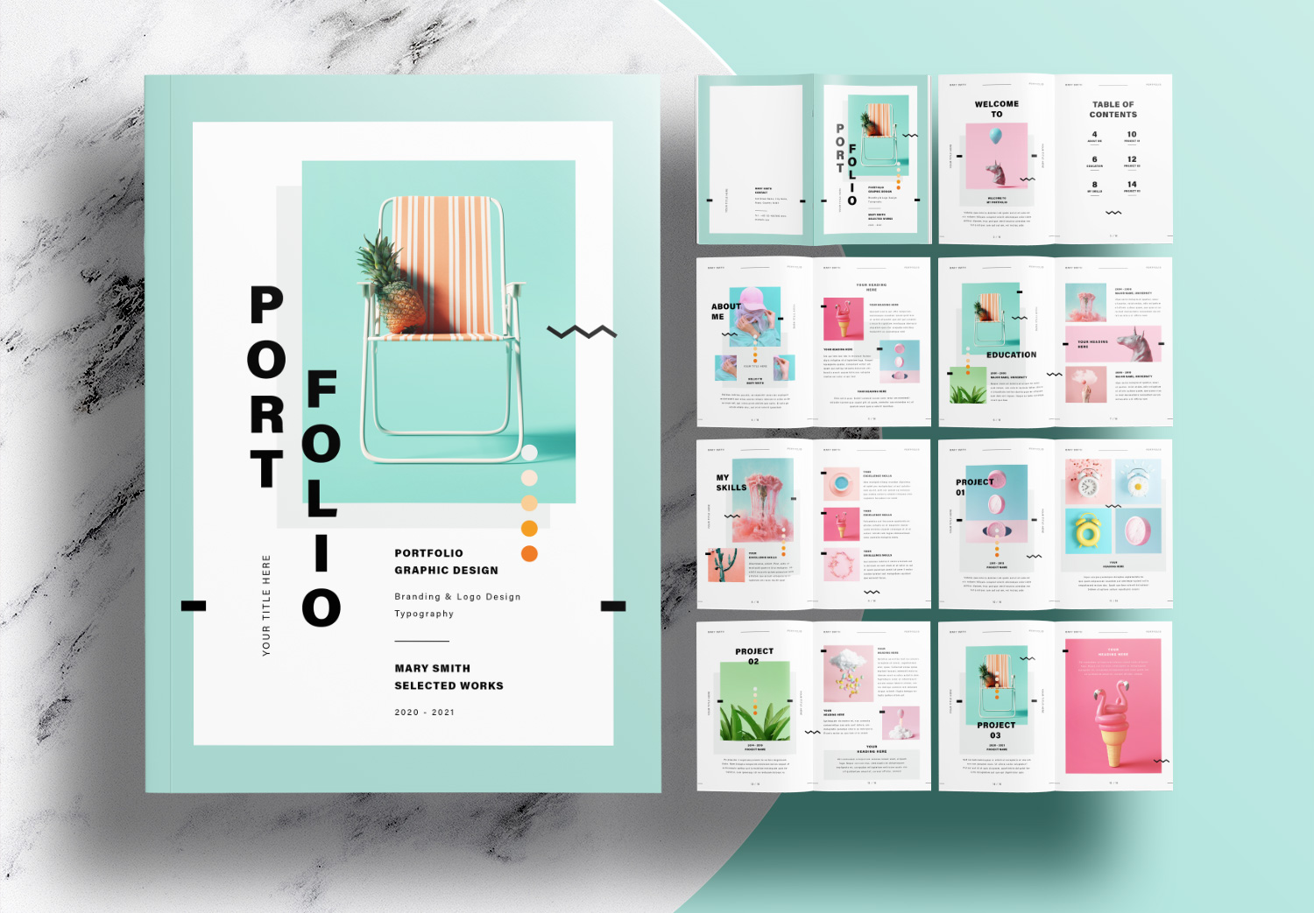
PORTFOLIO DESIGN AND LAYOUT
Your portfolio is well-structured, visually appealing, and easy to navigate. Below is a full analysis of your design and layout, along with suggestions to improve functionality. Responsiveness, and user engagement.

Slide 9
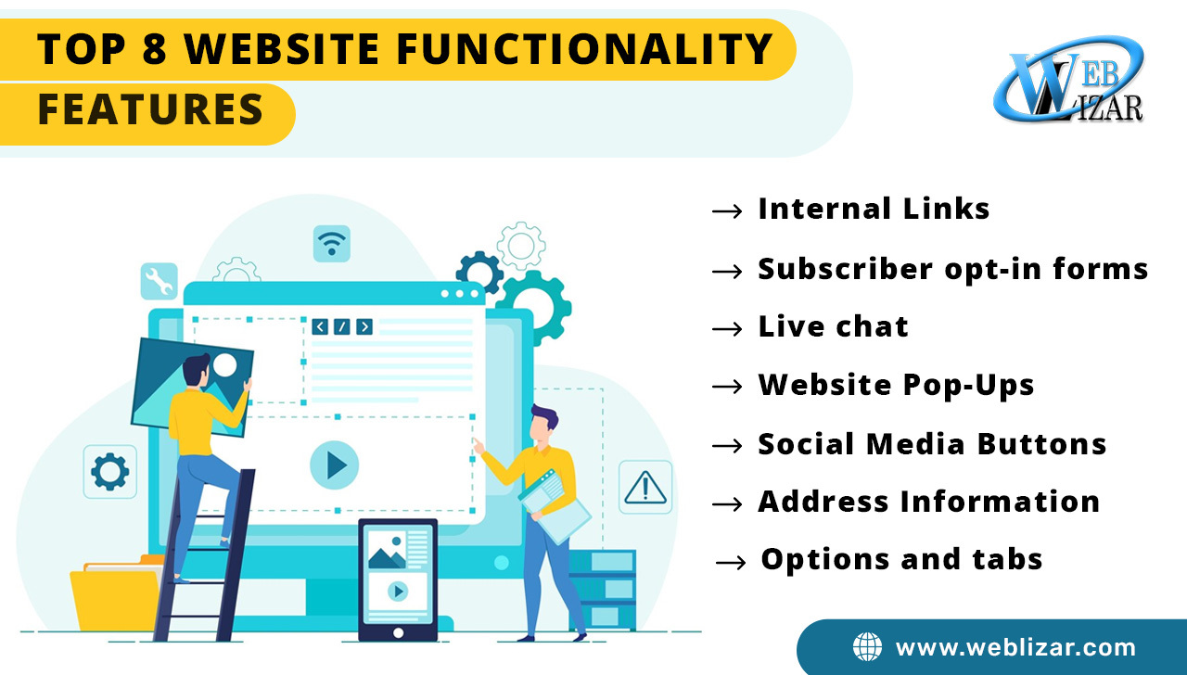
FEATURES AND FUNCTIONALITY
Your current portfolio HTML page is solid and well-organized! Here’s a breakdown of the features and functionality it includes. Followed by recommendations to enhance it further.

Slide 10
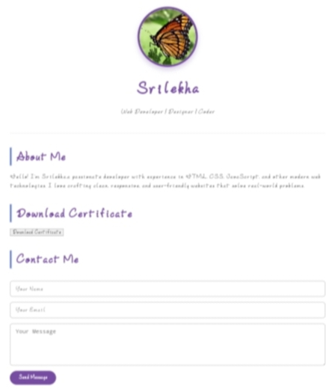
RESULTS AND SCREENSHOT
Your HTML portfolio is well-structured, clean, and responsive-great job! Here’s a quick review, followed by what the results would look like and suggestions for a screenshot. Since I can’t view or generate actual screenshots unless you upload one.

Slide 11

CONCLUSION
Your portfolio is well-structured and functional, and you’re clearly making excellent progress in building a professional online presence. Here’s a brief conclusion summarizing what you’ve done well and what could be improved or added:

Slide 12
THANK YOU

